Slide 1
Machining Processes

Slide 2
Machining
Removing unwanted material in the form of chips:
Turning
Sawing
Grinding
Milling
Shaping or planing
Broaching
Drilling

Slide 3
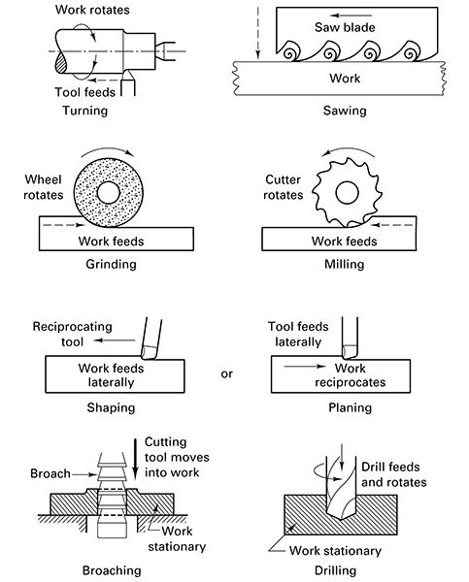
Seven Basic Machining Processes

Slide 4
Machining Process
Affected by:
Machine tool (the machine itself)
Cutting tool (geometry and material)
Workpiece (properties and material)
Cutting tool parameters
Speed
Feed
Depth of cut
Workpiece holding devices

Slide 5
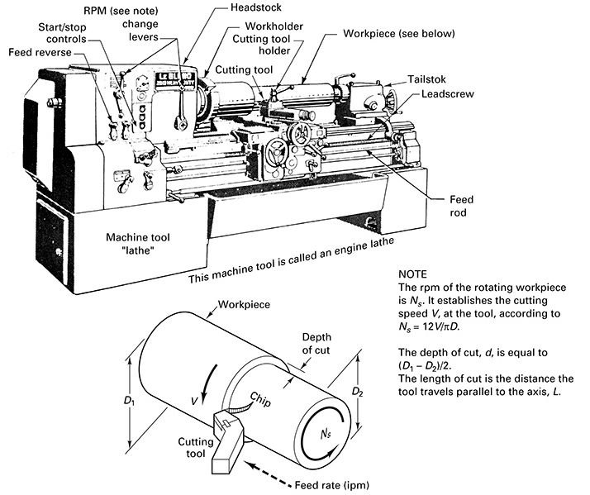
Cutting Parameters

Slide 6
Four Cutting Tool Parameters
1. Speed
2. Depth of Cut (DOC)
3. Feed Rate (f_{r})
4. Material Removal Rate (MRR)

Slide 7
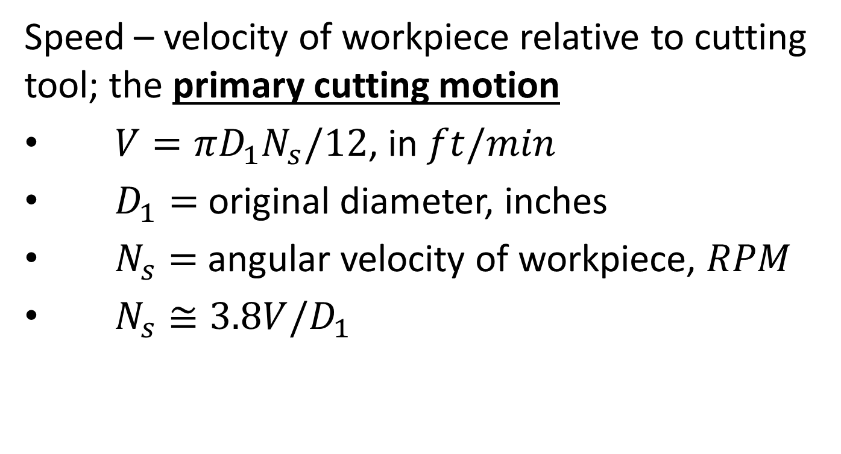
Speed
Speed – velocity of workpiece relative to cutting tool; the primary cutting motion
$V=πD_{1}N_{s}/12$, in $ft/min$
$D_{1}=$ original diameter, inches
$N_{s}=$ angular velocity of workpiece, $RPM$
$N_{s}≅3.8V/D_{1}$

Slide 8

Depth of Cut
Depth of Cut (DOC) – distance tool plunged into workpiece
$d=\left(D_{1}−D_{2}\right)/2$, inches

Slide 9

Feed Rate
Feed Rate ($f_{r}$) – amount of material removed per revolution (inches/rev)

Slide 10
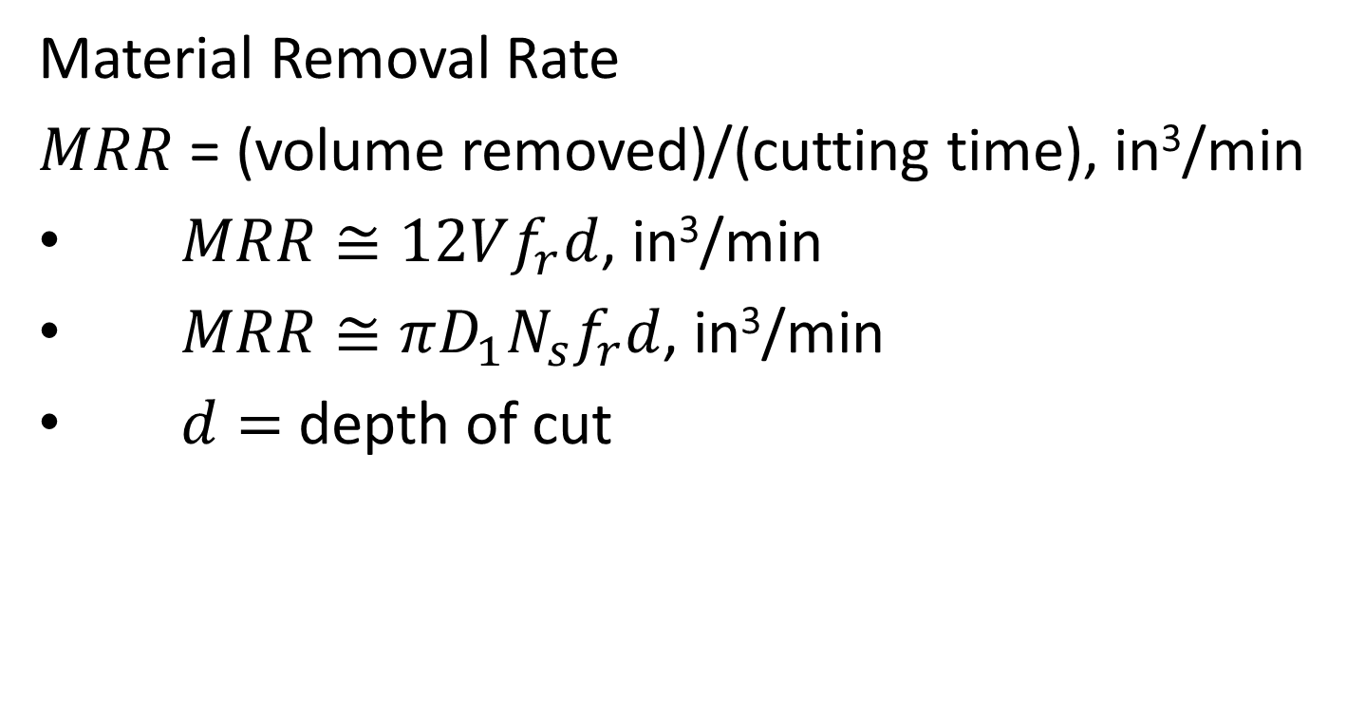
Material Removal Rate
Material Removal Rate
$MRR$ = (volume removed)/(cutting time), in³/min
$MRR≅12Vf_{r}d$, in³/min
$MRR≅πD_{1}N_{s}f_{r}d$, in³/min
$d=$ depth of cut

Slide 11
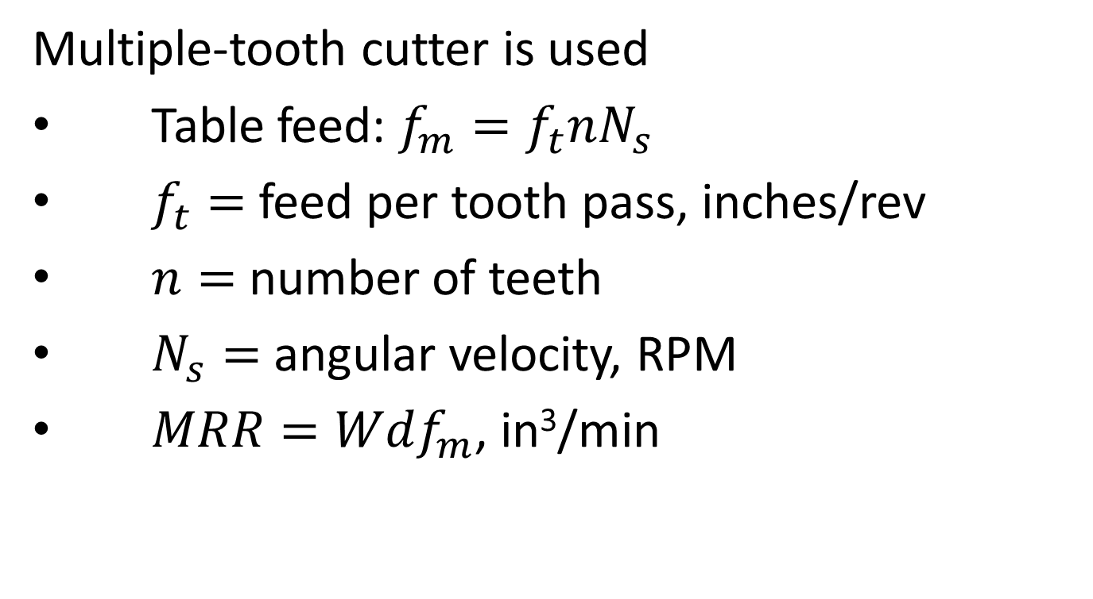
Milling Material Removal Rate
Multiple-tooth cutter is used
Table feed: $f_{m}=f_{t}nN_{s}$
$f_{t}=$ feed per tooth pass, inches/rev
$n=$ number of teeth
$N_{s}=$ angular velocity, RPM
$MRR=Wdf_{m}$, in³/min

Slide 12
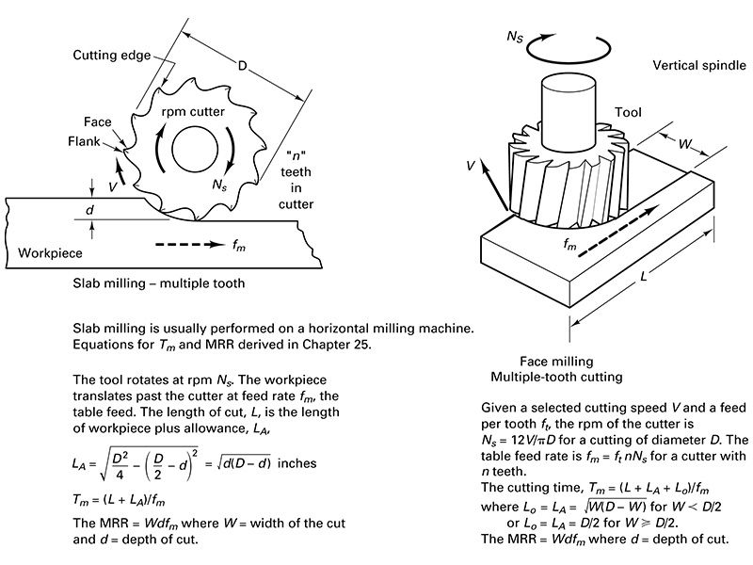
Slab/Face Milling Basics

Slide 13
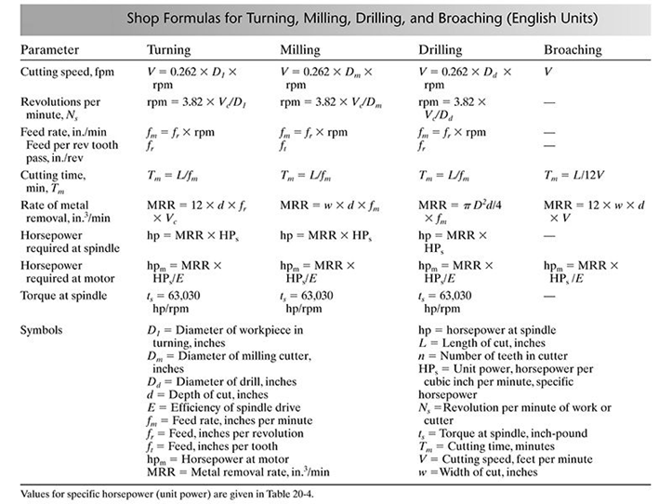
Shop Formulas for Various Processes

Slide 14
Lathe Turning

Slide 15
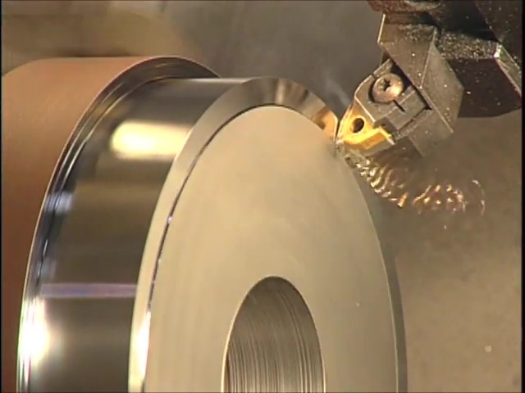
Watch Video Here

Slide 16
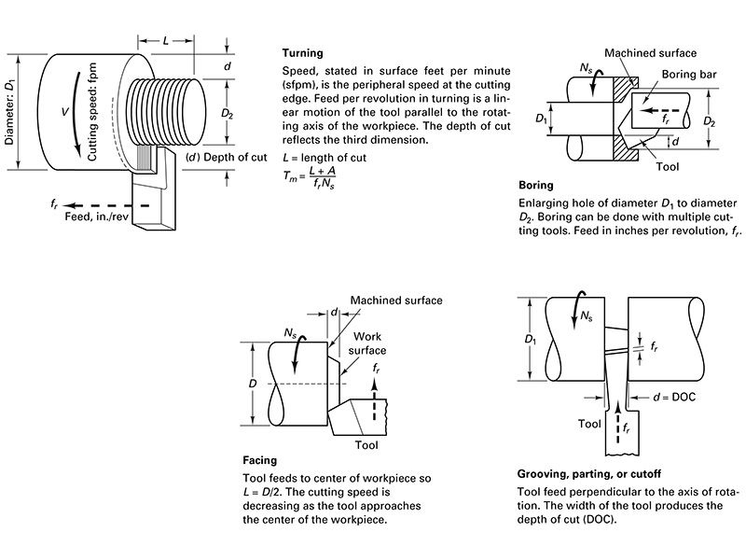
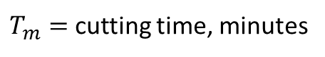
Lathe Turning
$T_{m}=$ cutting time, minutes

Slide 17
Boring Basics

Slide 18
Facing Basics

Slide 19
Grooving, Parting, or Cut-off

Slide 20
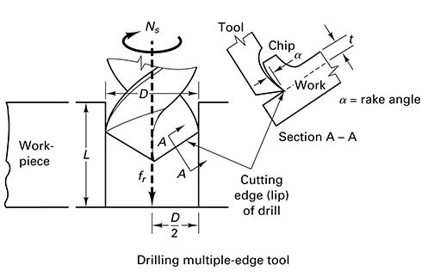
Drilling Basics

Slide 21
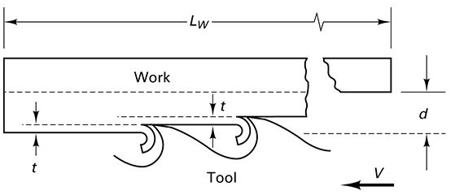
Broaching Basics

Slide 22
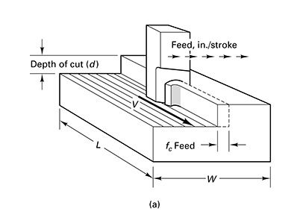
Shaping/Planing Basics

Slide 23
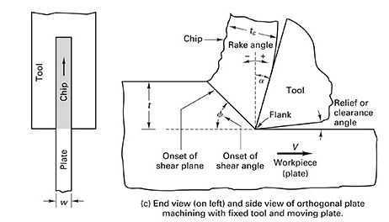
Understanding Chip Formation

Slide 24
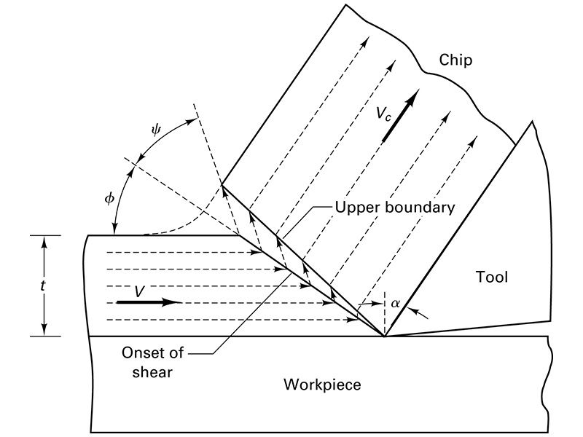
Removing a Chip

Slide 25

Effect of Workpiece Material Properties
Discontinuous
Continuous
Continuous
with built-up edge

Slide 26
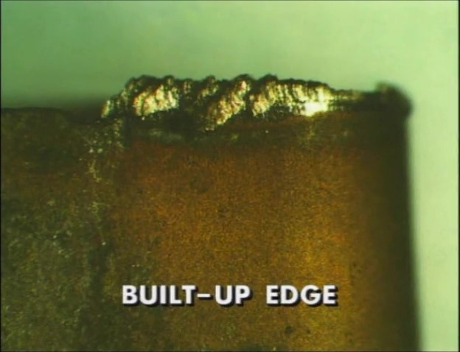
Watch Video Here
Notes:
Built-Up Edge

Slide 27
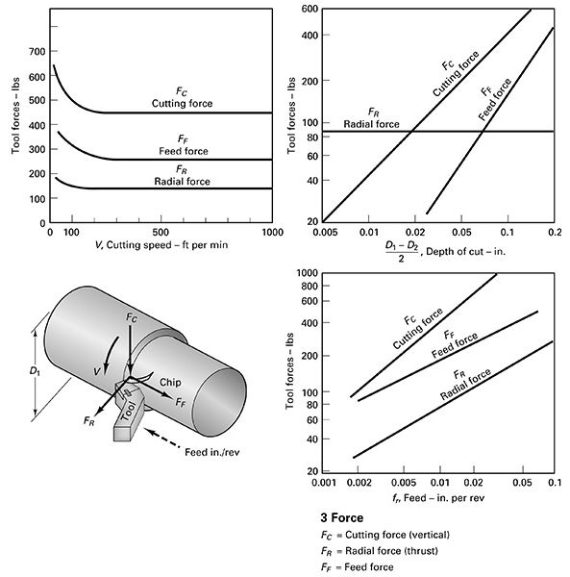
Energy and Power in Machining

Slide 28
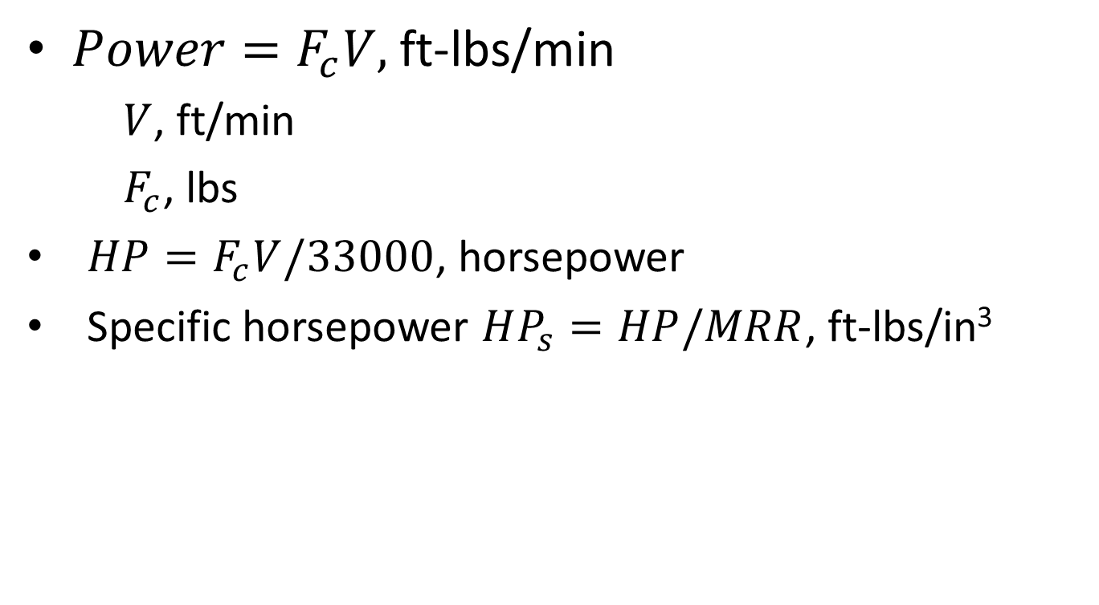
Power
$Power=F_{c}V,$ ft-lbs/min
$V$, ft/min
$F_{c}$, lbs
$HP=F_{c}V/33000$, horsepower
Specific horsepower $HP_{s}=HP/MRR$, ft-lbs/in³

Slide 29

Watch Video Here
Notes:
Tool Failure

